Slide 1
Data Technician Level 3 Training
Dirty data and data cleansing techniques

Slide 2
Competencies covered
K = Knowledge S = Skill
Data cleansing
K10: The range of common data quality issues that can arise e.g. misclassification, duplicate entries, spelling errors, obsolete data, compliance issues and interpretation/ translation of meaning
S16: Clean data i.e. remove duplicates, typos, duplicate entries, out of date data, parse data (e.g. format telephone numbers according to a national standard) and test and assess confidence in the data and its integrity
Validation
K11: Different methods of validating data and the importance of taking corrective action
S8: Apply cross checking techniques for identifying faults and data results for data project requirements
S9: Audit data results

Slide 3
End-Point Assessment
The following activities are required during the scenario demonstration of your End Point Assessment Organisation
Portfolio Describe the methods of validating data how to identify common data quality issues and the importance of corrective action
Scenario demonstration Cleanse the filtered data set of errors, correcting those where appropriate (e.g. removing duplicates, fixing spelling mistakes), highlighting others for further review (e.g. outliers), documenting all actions taken
Notes:
This is what the End Point Assessment Organisation are likely to ask you to do

Slide 4
Dirty data
Dirty data refers to data that contains erroneous information
The complete removal of dirty data from a source is typically seen as impractical or virtually impossible

Slide 5
Business implications of dirty data
Even a minor data error can set off major issues during the data analysis process.
Major issues that an organisation can face as a result of dirty data concern:
Cost
Accuracy
Inconsistency
Cleanliness
Reputation

Slide 6
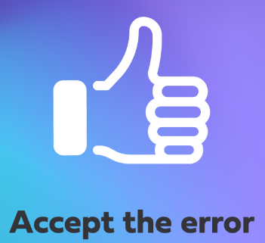
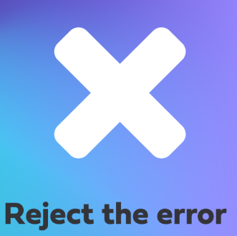
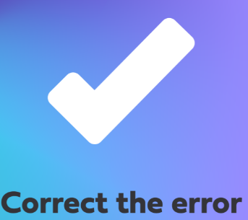

Corrective action
Notes:
Accept the error
Put simply, this means that you should take no further action to fix the error.
You may decide that the data error in question can be accepted if:
It’s not key to your objective
It’s not likely to be a recurring error that will affect every analysis
The cost of fixing it outweighs the gain
An example of an "acceptable" error could be 'Main Street' instead of 'Main St'. Depending on the purpose of your analysis, it may not be worth the effort or cost to correct it.
Reject the error
If you choose this option, this means you’ll need to remove the data from your dataset.
If the data cannot be corrected or verified, then it can be better to simply remove it from the dataset.
An example of this could occur when you find a date from the future, and you need to calculate a person’s age from their date of birth. Unless you can verify the correct date of birth, you’ll have to either remove that data point or the entire entry from the dataset.
Correct the error
When it comes to this action, you’ll need to correct the error you come across.
Consideration needs to be given to where the data is corrected. The correction can take place within the dataset or from the original data source.
One advantage of correcting an error at its source is that when the data is used at a later date, you’ll not come across this quality error again. In some cases, you may need to highlight to other stakeholders that this needs to be corrected at the source, however, in order to continue with your work, you’ll initially have to correct the data within the dataset.
An example could be a gender-related record that’s been misspelt, such as one entry saying ‘Mael’ instead of 'Male’.
Create a default value
For this action, you’ll need to create a data point for a missing/incorrect value.
When you discover that certain data is missing, it could be cleaner to create a default value.
An example of this could be how many people are working in different roles at a company’s head office, e.g. 'manager', 'CEO', and a number of career titles that are missing. Instead of leaving these as blank, you could add 'unknown'.

Slide 7
Benefits of correcting data
Reduced cost
Improved employee retention
Reduced risk
Compliance
Faster analysis
Improved productivity
Improved data quality
Accurate reporting and improved decision-making
This links to importance of corrective action (K11)
Notes:
This links to the importance of corrective action

Slide 8
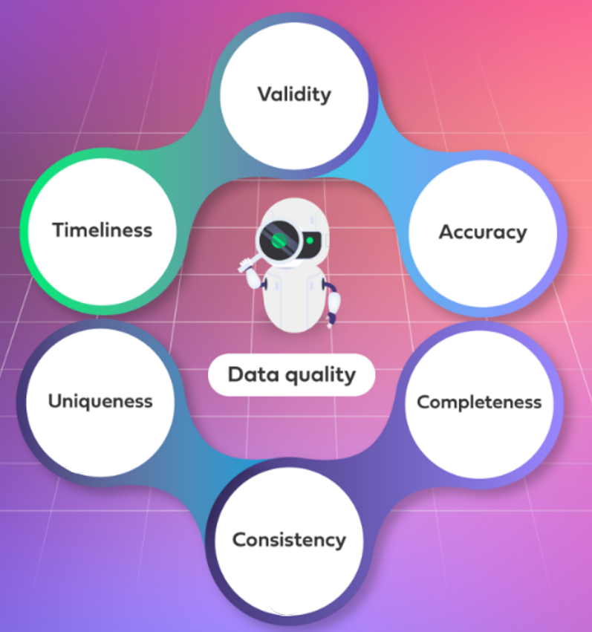

Measuring data quality
Notes:
Validity (Is it right in the cell – Eyeball – Sort and Distinct – alignment of column headers to data)
Validity is the extent to which your data abides by the expected range, formats, and types given. For example: valid postcodes and email addresses, month numbers between 1 and 12, as well as ages within a certain range.
Accuracy (Do I have enough data to represent the “topic” I am trying to understand?)
Data accuracy is how the data represents real life. It’s all about making sure that your data matches (or is close to) the true values. Measuring data accuracy requires verification with authentic references, such as birth records or with the actual entity.
Accuracy is an important one as data accuracy directly impacts the correctness of decisions. Some examples of this include spelling errors and misclassification.
Completeness (No Nulls or blanks, Presences check – Top/Bottom 10/20 – Random Rows – Eyeball check – Sort to check ranges)
The extent to which all required data is known. It can be measured as a percentage to state how much of the entire possible dataset is available and fit for purpose.
Let’s look at an example involving football season ticket holders. To find out how often the supporting fans visit the football ground during a certain date range, we would need the date of visit, first name and last name. The data would be considered 100% complete, as long as all of these details are present and valid.
If there were additional phone numbers within the dataset that were incomplete, this would not affect the completeness because these are not part of the required data.
Consistency (Check against datasets/columns to ensure cell is correct e.g., DOB = DOB – Club owner asks for driving license and then asks for your DOB to check for consistency)
Consistency means that data from across all the systems should reflect the same information. It should also be synchronised with other data from the business.
Uniqueness (Checking for duplicates using Sort and scan the data / count of rows and distinct values *for unique ids)
Uniqueness is a measure of how many duplicates the data contains. It’s important to note that duplicates can occur, even when some of the data is the same.
For instance: a customer can have two records with the same core details, like name and customer ID but one record has a different contact number or postal address to the other. Despite not having exactly the same details, this is still the same customer, and can therefore be categorised as a duplicate.
Make sure to watch out for this characteristic when combining datasets.
Timeliness (Check data has the right range for the purpose and relevant – Max/Mins of dates)
This characteristic looks at whether the data is available and as up-to-date as it can be.
Sometimes, the data we need has to be both available and extremely timely (as in correct up to the very day or minute). At other times, however, we are working with monthly or yearly data.
Remember: data quality may decay over time. It is therefore very important to be cautious when using older data to drive decisions.

Slide 9

Collaboration
What examples of dirty data have you experienced?
Notes:
Duplicate data
A duplicate entry can be created through repeated submissions by the end user, poor business rules, or insufficient validation checks when saving data.
Duplicates can also be created when joining the data incorrectly, or failing to clear existing data before loading new data.
Incomplete/Missing Values
Missing data can be intentional by design. For example, imagine you are filling out a survey that asks you whether you have children, and if so, how many children you have. If you don’t have children, it would be acceptable for you to skip the follow-up question on the number of children you have.
Missing data can also be unintentional. An example of this could be where survey participants choose to skip a question that researchers had expected everyone to answer, or when data has been lost during the Extract, Transform and Load (ETL) process.
Incorrect Data
Incorrect data is usually due to human error and can be intentional or unintentional.
There are three reasons for intentionally entering incorrect data:
If the correct data is unknown or deemed unimportant to the process but must be entered to continue. If so, a random value is entered to continue.
Secondly, if the correct information is not necessary to get the result you require. An example of this is when filling in an online marketing form to gain access. A person’s name, age, phone number, marital status, annual income and/or education level may be filled in incorrectly to gain access.
The third reason is data is deliberately incorrect to gain a benefit. This would be considered fraud and must be reported.
Unintentional incorrect data is created by accident. An example of this would be a spelling mistake or selecting the wrong option from a drop-down list when entering the data. Data can also be lost when saving or moving data.
Non-integrated Data
Non-integrated data relates to data that resides in different tables or data sources.
This type of data needs to be combined/joined, in order to answer any business questions that cannot be answered when the data resides in separate silos.
Remember: if the data has not been integrated, you may find it difficult to get a full picture of a business problem that you’re trying to solve.
Misleading Data
Misleading data sets can lead readers into believing something that isn't true.
This can occur when raw data is collected from a sample that is not representative of the whole population. Processing this raw data creates a bias within the information, which can lead to biased business decisions.
Formatting
This type of data issue can occur when data isn’t formatted correctly. An example of this is where a number, date or telephone number is formatted incorrectly.
Here’s some key tips to remember:
The ISO’s standard for date formatting is YYYY-MM-DD
Telephone numbers should match up with their own national standard
In the UK, this would involve removing the first zero, and replacing it with +44
Irrelevant/Unnecessary
Irrelevant data that goes unchecked can lead to data inconsistencies.
It’s imperative to consider the rules or standards in which your company will need to conform to, such as the General Data Protection Regulation (GDPR) or Data Protection Act.
Remember: under GDPR, any data that’s irrelevant or unnecessary must be removed.
User entry errors will also result in low quality, erroneous data:
Poorly applied coding standards
Different schemas
Legacy systems
Evolving applications
No unique identifiers
Data migration
Programmer error
Data corruption in transmission

Slide 10
Data cleansing
Data cleansing (or 'data scrubbing') is the action of identifying and then removing or amending dirty data.
The following actions will help in detecting and correcting dirty, corrupt data found in a database, table, or record set:
Filtering
Blending
Interpolation
Masking
Transformation
Notes:
Filtering
Data filtering is the act of refining data. The dataset is distilled into what a user (or group of users) needs, without including additional data that may seem repetitive, irrelevant, or even sensitive.
An example of this would be where you’ve been asked to report on the business’ total revenue for the last month; however, to produce this report, you must extract only last month's data from the revenue data.
Blending
Sometimes, the answer to a business question cannot be found by analysing a single data source. In these instances, you may wish to blend or join your data.
There are many types of joins, but the most common type is the left join. Others include right join, inner join, and full outer join.
As well as combining data together, you can also filter your data using joins or specific clauses that exclude rows (tuples) or columns (attributes).
Interpolation
Interpolation is an estimation technique used to construct new data points when you already have the data but it has some missing values. When a large part of your data is missing, be aware of the bias you might be creating when using interpolation.
Let’s now look at an example of this. In the example provided here, we want to find the value of ‘Y’.
When looking at the table, we can see that the value for point ‘X’ is 8.
Once plotted on a graph, we can use ‘X’ as 8 to indicate the value of ‘Y’, which in this case is 25.
Masking
Masking is used to protect sensitive data by creating a structurally similar (yet inauthentic) version of an organisation's data. This in turn can be used for software testing and user training purposes.
To remain compliant with GDPR, businesses can anonymise any sensitive employee data, to protect their staff members and still gain value from the analysis.
Transformation
Data transformation is the process of converting data or information from one format into another. This is usually taken from the format of a source system and goes into the required format of a new destination system.
Some transformation techniques include, but are not limited to, encoding, case converting, binning, and creating calculated fields.
An example of transformation is calculating a new column, such as ‘Profit’, by calculating ‘Revenue’ minus any ‘Cost’ columns.
Data cleansing (or 'data scrubbing') is the action of identifying – and then removing or amending – any data within a record set, table or database that is:
Incorrect
Incomplete
Duplicated
Incompatible
Missing values
And, under GDPR rules:
Irrelevant/unnecessary
This is usually done in a bulk process – either regularly or as a one-off – using technology that works well with the overall procedure

Slide 11
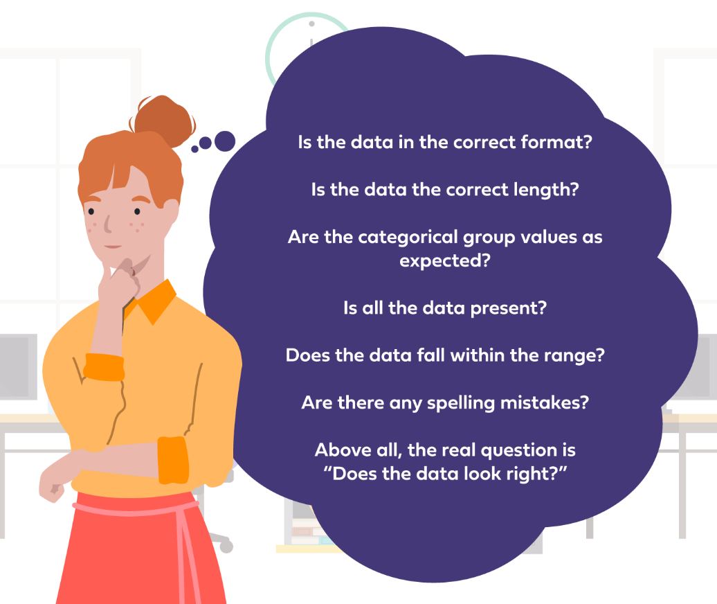
Validation questions

Slide 12
Methods of validating data
Format
Check
Count
Check
Length
Check
Cross
Check
Distinct
Check
Complete
Check
Range
Check
Spell
Check
Achieved through
Eyeballing
Sort
Filters
Reference
Table
Min/Max
Function
Count/Sum
Function
Average
Function
Basic statistical measures
Notes:
Format check (Validity)
Is the data in the correct format?
One example of formatting is the ISO’s standard for date formatting, which is YYYY-MM-DD
Telephone numbers should match up with their own national standard. In the UK, for instance, this would involve removing the first zero and replacing it with +44
A different example is that a UK citizen’s National Insurance number, which starts with two letters and is followed by six numbers and one final letter
Length check (Validity)
Looking at your data, is it the correct length?
For instance, a UK National Insurance number (NINO) must be nine characters long
Cross Check table (Validation and Consistency)
Are the categorical group values as expected?
An example of this could be how you refer to a person. There are a finite number of titles available to an individual, e.g. Mr, Mrs, Ms, Master, Miss, Dr, and Revd
Cross-checking involves using multiple sources of data to confirm the validity and accuracy of the data. In addition, any discrepancies that are found would need to be investigated, fixed and then reconciled.
Complete (presence) check (Validity and Completeness)
Is all the data present? For instance, common keys should always have a value. There may also be other important fields that must include a value
Range check (Validity and Completeness)
Does the data fall within the range?
Age must be greater than 0. In fact, in some cases, the age may need to be 18 or over (>=18)
Another example is the European working time directive. According to this directive, the hours worked should be less or equal to 48 hours, and no negative number of hours worked
Spell check (Validation)
Are there spelling mistakes?
Spelling mistakes will need correcting if you’re going to use or encode the data
Count check (Validity and Uniqueness)
Distinct Check (Uniqueness)

Slide 13
Audit data results
This simply means check your results before you share, present or deliver.
Consider this the final quality step. This may be completed by yourself or, within larger companies, someone else may need to check/audit your work.
Take notes of any data changes you have implemented.
The full technical documentation will support this and is covered in Module 5.
What questions would you ask yourself at this stage?
What assumptions were made and were they justified?
Was the data sufficient?
Did the data answer the question/support the decision?
How can you improve?

Slide 14
Questions?
Notes:
Any questions?

Slide 15

Thank You
careers@archapprentices.co.uk
https://www.avadolearning.com/arch-apprenticeships/

